Slide 1

Geometry
Unit 6, Lesson 7 Triangle Similarity Volume 1, pg. 326

Slide 2


Benchmark
MA.912.GR.1.2
Prove triangle congruence or similarity using Side-Side-Side, Side-Angle-Side, Angle-Side-Angle, Angle-Angle-Side, Angle-Angle, and Hypotenuse-Leg.
volume 1, pg. 326

Slide 3
Integrated Mathematical Thinking and Reasoning Standards
MA.K12.MTR.1.1 Actively participate in effortful learning both individually and collectively.
MA.K12.MTR.2.1 Demonstrate understanding by representing problems in multiple ways.
MA.K12.MTR.4.1 Engage in discussions that reflect on the mathematical thinking of self and others.
MA.K12.MTR.5.1 Use patterns and structure to help understand and connect mathematical concepts.
volume 1, pg. 326

Slide 4

Learning Targets
I can identify similar triangles and write similarity statements.
I can use given information to show that two triangles are similar.
volume 1, pg. 326

Slide 5

Warm-Up
volume 1, pg. 326

Slide 6
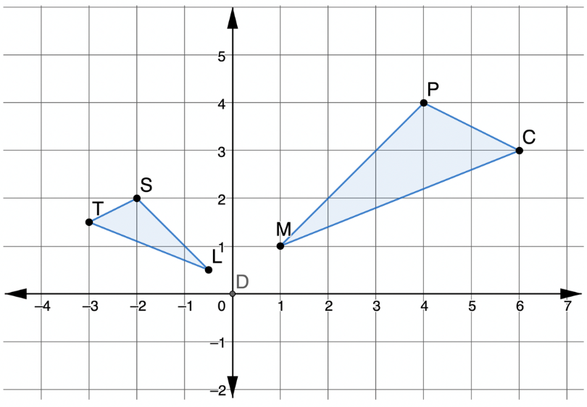

6.7.1 Warm-Up: Bell Work
$∆MPC$ and $∆TSL$ are shown on the coordinate grid, where $∆MPC$ is the pre-image.
Describe a sequence of two transformations that will map $∆MPC$ onto $∆TSL$.
volume 1, pg. 326

Slide 7

Exploration
volume 1, pg. 327

Slide 8

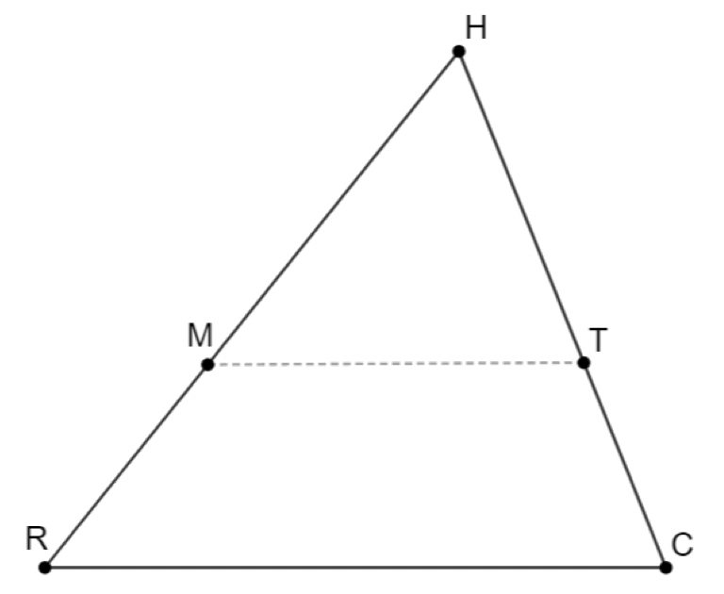
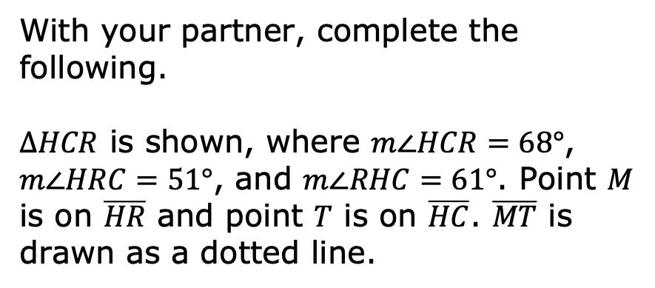
6.7.2 Exploration: Similar Triangles
With your partner, complete the following.
$∆HCR$ is shown, where $m∠HCR=68°$, $m∠HRC=51°$, and $m∠RHC=61°$. Point $M$ is on $\overline{HR}$ and point $T$ is on $\overline{HC}$. $\overline{MT}$ is drawn as a dotted line.
volume 1, pg. 327

Slide 9

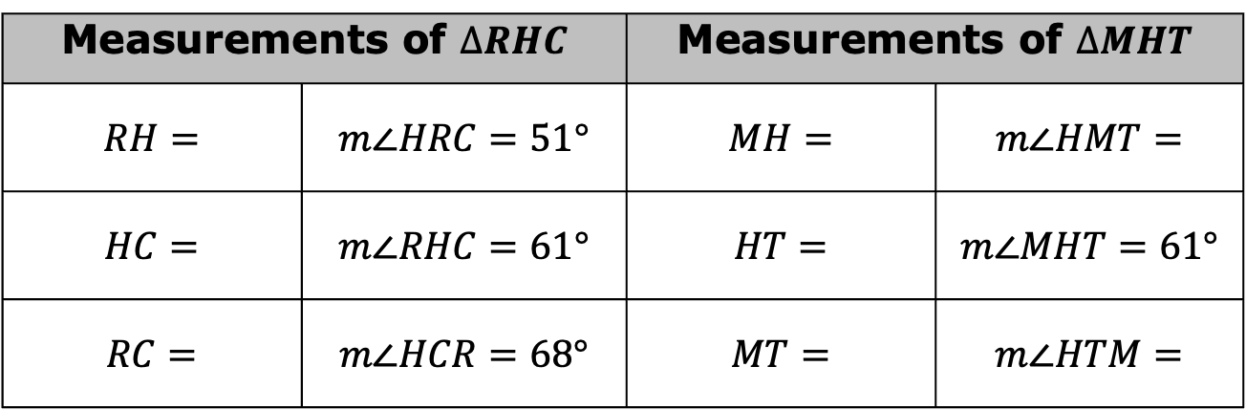
Use a ruler and a protractor to complete the table.
What do you notice about the corresponding angles of $∆RHC$ and $∆MHT$?
Measurements of $∆RHC$ |  | Measurements of $∆MHT$
$$RH=$$ | $$m∠HRC=51°$$ | $$MH=$$ | $$m∠HMT=$$
$$HC=$$ | $$m∠RHC=61°$$ | $$HT=$$ | $$m∠MHT=61°$$
$$RC=$$ | $$m∠HCR=68°$$ | $$MT=$$ | $$m∠HTM=$$
volume 1, pg. 327

Slide 10
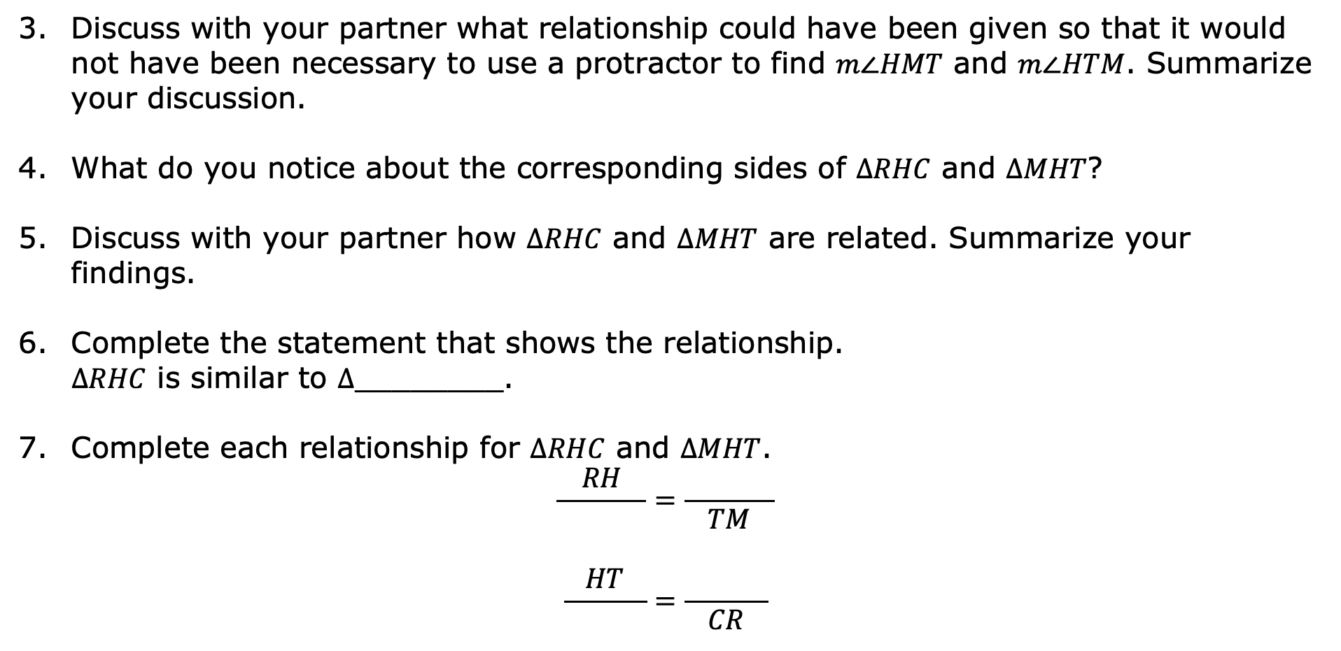
Discuss with your partner what relationship could have been given so that it would not have been necessary to use a protractor to find $m∠HMT$ and $m∠HTM$. Summarize your discussion.
What do you notice about the corresponding sides of $∆RHC$ and $∆MHT$?
Discuss with your partner how $∆RHC$ and $∆MHT$ are related. Summarize your findings.
Complete the statement that shows the relationship.
$∆RHC$ is similar to $∆$________.
Complete each relationship for $∆RHC$ and $∆MHT$.
$$\frac{RH}{ }=\frac{ }{TM}$$
$$\frac{HT}{ }=\frac{ }{CR}$$
volume 1, pg. 327

Slide 11
Discuss with your partner a sequence of transformations that can be used to map $∆RHC$ onto $∆MHT$. Summarize your discussion by describing the sequence.
volume 1, pg. 328

Slide 12
Compare your sequence of transformations with another pair of students. Ask two classmates for their sequence of transformations. Record their sequence and write your summary of their reason. You are the only person who should write in the first two columns of the table. Have the person initial next to your summary stating your summary is correct.
What transformation ensures that the sequence of transformations will result in similar triangles?
Sequence | My Summary of Their Reason | Initials
volume 1, pg. 328

Slide 13

Your Turn
volume 1, pg. 328

Slide 14
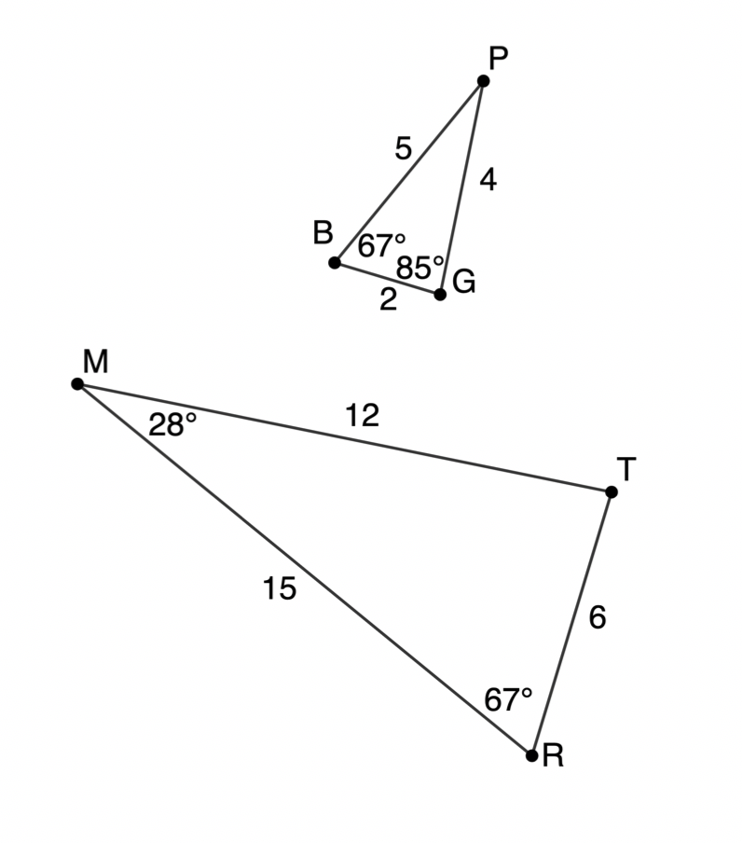
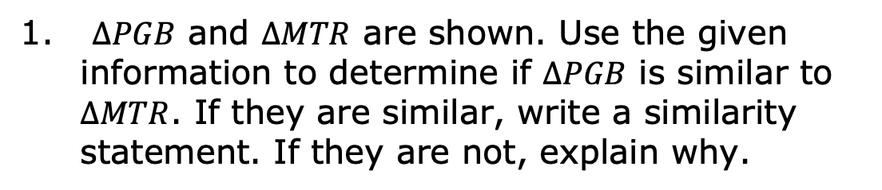
6.7.3 Your Turn!
$∆PGB$ and $∆MTR$ are shown. Use the given information to determine if $∆PGB$ is similar to $∆MTR$. If they are similar, write a similarity statement. If they are not, explain why.
volume 1, pg. 328

Slide 15

Activity
volume 1, pg. 329

Slide 16

6.7.4 Activity: Stations
With your partner, create two triangles using the description provided. Try to make the two triangles as different as possible.
Description Letter | Drawing
volume 1, pg. 329

Slide 17
Description Letter | Drawing
volume 1, pg. 329

Slide 18
Description Letter | Drawing
volume 1, pg. 330

Slide 19
Description Letter | Drawing
Which descriptions resulted in similar triangles?
volume 1, pg. 330

Slide 20


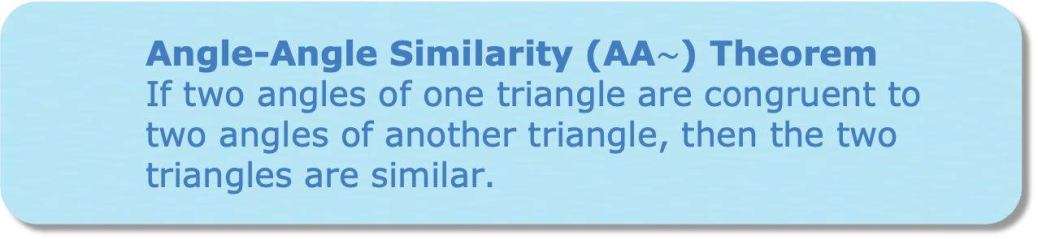
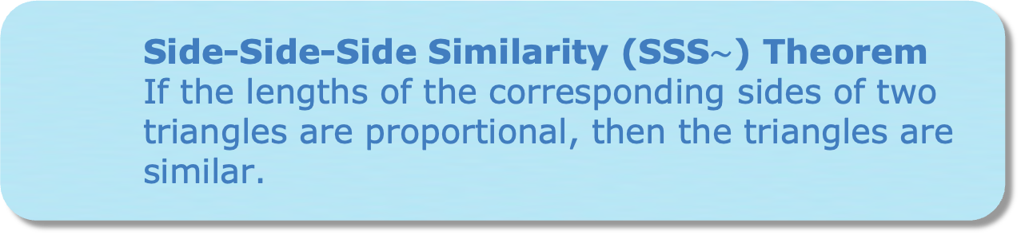
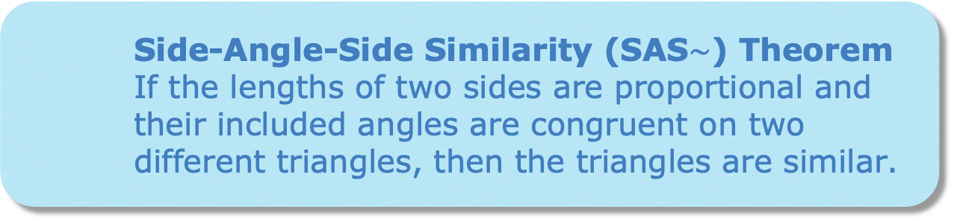
Angle-Angle Similarity (AA$\sim$) Theorem
If two angles of one triangle are congruent to two angles of another triangle, then the two triangles are similar.
Side-Side-Side Similarity (SSS$\sim$) Theorem
If the lengths of the corresponding sides of two triangles are proportional, then the triangles are similar.
Side-Angle-Side Similarity (SAS$\sim$) Theorem
If the lengths of two sides are proportional and their included angles are congruent on two different triangles, then the triangles are similar.
volume 1, pg. 331

Slide 21
Match each description with the postulate or theorem that describes it. If none describe it, then write “none.”
Description Letter | Theorem
volume 1, pg. 331

Slide 22

Wrap-Up
volume 1, pg. 331

Slide 23
6.7.5 Wrap-Up: Cool Down
Write a summary of what you learned in this lesson.
volume 1, pg. 331

